Slide 1
Performance Testing Methodology & Approach for Client
Performance Testing Methodology & Approach for P&G
Version – 0b

Slide 2
Content
Performance Test Life Cycle Stages
Performance Requirements Gathering – BP Phase
Performance Requirements Gathering – D&C Phase
Test Planning and Strategizing
Test Scripting and Development
Test Execution, Analysis & Reporting
Plan for subsequent release
Dependencies
Risks and Mitigations
Need for a Performance Testing Tool?
Tools Overview (LoadRunner/Performance Cen<1000071>)
Next Steps

Slide 3
Performance Test Life Cycle Stages
Project Initiation
Blue Printing
Design and Construction
SIT
BAT
Post Go-Live Support
How will I do my business af<1000071> the change?
Engage Performance Testing Team
Cutover and Go-live
Inputs from performance test team for go-no-go discussions
Performance Testing
High level Business Requirements/Flows Available on Paper
Performance Requirements Gathering – BP Phase
Performance Requirements Gathering – D&C Phase
Perf Test Planning & Strategizing
Script Develop-
ment
Test Execution
& Analysis
Plan for subsequent release
Performance requirements relating to Order Cycle
response time for existing key SAP transactions/processes
Gap sheet
Performance requirements definition
Test strategy document.
Test cases.
Gap sheet
Test Scripts
Test Results
Results analysis report.
Closure report.
Deliverables
All deliverables to be uploaded against appropriate SOP in MEGA

Slide 4
Performance Requirements Gathering – BP Phase
Performance Requirements Gathering
Perf Test Planning & Strategizing
Perf Script Development
Test Execution
& Analysis
Plan for subsequent release
Entry Cri<1000071>ia
Commencement of Blue Printing phase
Deliverables / Exit Cri<1000071>ia
Signed-off Performance Requirements
document
Activity | Input / Pre-requisites | Infosys FAL | Infosys PT team | BRL / BE / SO | Infosys implementation team
Integration Manager and FALs: Document performance requirements relating to Order Cycle Document response time for existing key SAP transactions/processes Gap sheet |  | P, E |  | A, E | C
P – Plans, A – Approves, C – Contributes, E - Executes

Slide 5
Performance Requirements Gathering – D&C Phase
Performance Requirements Gathering
Perf Test Planning & Strategizing
Perf Script Development
Test Execution
& Analysis
Plan for subsequent release
Entry Cri<1000071>ia
Completion of Blue Printing phase
On-boarding of performance test resources
Deliverables / Exit Cri<1000071>ia
Signed-off Performance Test Requirements
document
Activity | Input / Pre-requisites | Infosys FAL | Infosys PT team | BRL / BE / SO | Infosys implementation team
PG: Performance Testing kick-off. Identifying stake holders and SMEs Providing performance test requirements including SLAs Providing load pat<1000071>n & volume information. Performance environment identification. | High level solution design with architecture diagrams. Functional design documents. Technical design documents. Existing Performance Requirements, if any |  | P, E | A, C | C
Infosys: System appreciation Performance requirements analysis & prioritizing scope Workload modeling.
P – Plans, A – Approves, C – Contributes, E - Executes

Slide 6
Test Planning and Strategizing – D&C Phase
Performance Requirements Gathering
Perf Test Planning & Strategizing
Perf Script Development
Test Execution
& Analysis
Plan for subsequent release
Entry Cri<1000071>ia
Completion of Blue Printing document.
Performance Requirements document.
Deliverables / Exit Cri<1000071>ia
Baseline Performance Test Plan
Workload modeling report
Project Plan with schedule, timelines and resources incorporated
Activity | Input | Infosys FAL | Infosys PT team | BRL / BE / SO | Infosys implementation team
Infosys: Prepare performance test strategy Identify test data requirements Identify performance test types & scenarios. Define tool infrastructure requirements and license requirements Validate offshore connectivity | High level solution design with architecture diagrams. Functional design documents. Technical design documents | C | P, E | C | C
PG: Provide offshore connectivity. Provide details of the available tools and monitoring infrastructure.
P – Plans, A – Approves, C – Contributes, E - Executes

Slide 7
Test Script Development – SIT Phase
Performance Requirements Gathering
Perf Test Planning & Strategizing
Perf Script Development
Test Execution
& Analysis
Plan for subsequent release
Entry Cri<1000071>ia
Signed-off Performance Test Plan & Performance Requirements document
One round of SIT completed (preferably)
Performance Test environment and Test Tools set up available & ready for scripting.
Deliverables / Exit Cri<1000071>ia
Test suite ready for test execution
Activity | Input | Infosys FAL | Infosys PT team | BRL / BE / SO | Infosys implementation team
Infosys: Creation of Scripts using LoadRunner (Vugen) Reviews/ Smoke Testing of all scripts Standardization of test scripts Incorporating review comments from PG | One round of SIT complete Authorization for performance test scripting in SIT environment Testing tool infrastructure ready | C | P, E | C
PG: Review scripts from PG standards point of view
P – Plans, A – Approves, C – Contributes, E - Executes

Slide 8
Execution, Analysis & Reporting – SIT 2 & BAT Phase
Performance Requirements Gathering
Perf Test Planning & Strategizing
Perf Script Development
Test Execution
& Analysis
Plan for subsequent release
Entry Cri<1000071>ia
Test Suite available
Availability of dedicated Performance Environment
Functionally stable solution
Deliverables / Exit Cri<1000071>ia
Performance test results and findings shared with stake holders
No critical performance defects pending closure
Closure report signed off by key stakeholders.
Activity | Input | Infosys FAL | Infosys PT team | BRL / BE / SO | Infosys imp. team, HP,SAP,Vendor
PG: Refresh/clean up mas<1000071> data for test executions Participate in results review. | Test Suite readiness. Authorization to execute performance tests in SIT/BAT environments | C | P, E | C | C
Infosys: Perform sanity tests to verify test suite and test environment readiness before each major test i<1000071>ation Execute individual workflow/object in isolation during SIT Execute combined workflows during BAT Capture monitoring statistics Collate performance test results and do analysis. Prepare results report.
P – Plans, A – Approves, C – Contributes, E - Executes

Slide 9
Defect Resolution Process
Performance Requirements Gathering
Perf Test Planning & Strategizing
Perf Script Development
Test Execution
& Analysis
Plan for subsequent release
Defect Review
Defect due to
Third Party System?
Yes
Assign Defect to
Vendor Team
No
Yes
Defect due to
enhancement?
Defect due to
Configuration Or
Infrastructure?
Defect due to
Standard SAP Code
No
No
Yes
Yes
Assign Defect to
Development Team
Assign Defect to
HP Basis Team
Assign Defect to
SAP
Fix Defect
Defect Ready for Re-Test

Slide 10
Plan for subsequent releases
Performance Requirements Gathering
Perf Test Planning & Strategizing
Perf Script Development
Test Execution
& Analysis
Plan for subsequent release
Document the performance parame<1000071>s captured in the current release. These parame<1000071>s will act as benchmark for subsequent release.
Prepare a checklist for next release based on the tuning and fixes done in the current release.
Document the challenges and lessons learnt from the current release.

Slide 11
Dependencies
Team | Support / Dependency | Turn-around
DBA Team | Database Performance Metrics & Logs and Profiling Reports Gathering | 1 Day
Point of Contact | Single point of contact for the entire engagement execution support | 1 Day
Test Environment | Test environment should be available to carry out performance tests | 1 Day
Data Volume | Production Data Volume should be available in test environment for performance test execution | 2 Days
Load Testing / Monitoring Tool(s) | Required licenses for Load Testing tools, Access to install enable monitoring scripts on-need basis | 2 Days
Architecture / Design Documents | Documents should be available for Study and Review in System Study phase | 1 Day

Slide 12
Risks and Mitigations
Risk | Impact | Owner | Mitigation Plan
Performance test environment not equivalent to production environment | High | Implementation Team | Provide a performance test environment equivalent to production environment.
Shared performance test environment. | Medium | Implementation Team | Provide a clear environment sharing plan in advance or provide a dedicated environment.
Instability in the environment / enhancements may lead to scope creep. | High | Implementation Team | Implementation team should share the unit testing plan before and results af<1000071> unit testing. Box validation to be added as part of SIT Box preparation activity
Non availability of test environment during testing | Medium | SCQV and XSL-SCQV | Align with PG platform owner for refresh and test dates
Unreliable network connectivity from offshore | Medium | Implementation (in collaboration with P&G Platform ) teams | Single point of contact. System down time plan Define escalation procedures
Issues with test data (incomplete, incorrect, missing) availability for testing | High | Testing and GDM Team | Single point of contact. Test data reqmts. to be published by the testing team before SIT Issues resolution as per the SLAs set by the testing team

Slide 13
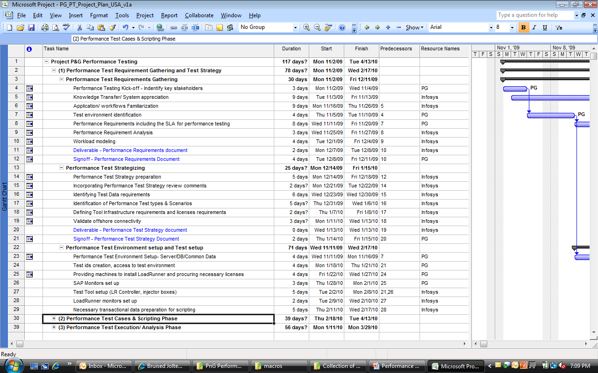
Timelines

Slide 14
Sample Templates
Sample templates to be used during the “Test Requirement Phase”
Requirement Questionnaire
Performance Requirement

Slide 15
Tools Overview – Performance Test Environment Setup
Onsite
LR Environment
QA Environment
Controller
SAP App
Servers
Analysis
Load generator
SAP
DB
Offshore/ODC
VuGen
VuGen
VuGen

Slide 16
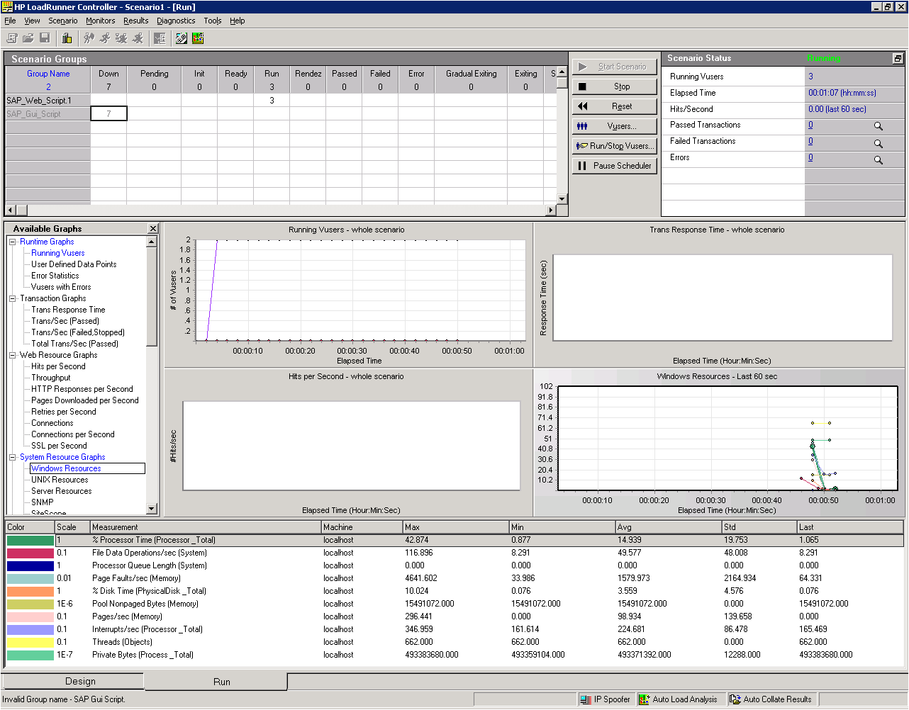
Tools Overview - Running and Monitoring Scenario
Scripts and users running against each script
Scenario status
Available Monitors
Live performance statistics graphs
Performance statistics for selected graph
Notes:
LoadRunner provides the following online monitors:
The Run-Time monitor displays the number and status of Vusers
participating in the scenario, as well as the number and types of errors that
the Vusers generate. It also provides the User-Defined Data Point graph that
displays the real-time values for user-defined points in a Vuser script.
The Transaction monitor displays the transaction rate and response time
during scenario execution.
The Web Resource monitor measures statistics at the Web server(s) during
scenario runs. It provides information about the number of Web
connections, throughput volume, HTTP responses, server retries, and
downloaded pages during the scenario.
The System Resource monitors gauge the Windows, UNIX, TUXEDO, and
SNMP resources used during a scenario. To activate the System Resource
monitors, you must set the monitor options before you run your scenario.
The Network Delay monitor displays information about the network delays
on your system. To activate the Network Delay monitor, you must set up the
network paths to monitor before you run your scenario.
The Firewall monitor measures statistics at the firewall servers during the
scenario. To activate the Firewall monitor, you must set up a list of resources
to monitor before you run your scenario.
The Web Server Resource monitors measure statistics at the Apache,
Microsoft IIS, and iPlanet/Netscape Web servers during the scenario. To
activate the Web Server Resource monitors, you must set up a list of
resources to monitor before you run your scenario.
The Web Application Server Resource monitors measure statistics at the
Web application server(s) during the scenario. To activate the Web
Application Server Resource monitors, you must set up a list of resources to
monitor before you run your scenario.
The Database Server Resource monitors measure statistics related to the
SQL server, Oracle, Sybase, and DB2 databases. To activate the Database
Server Resource monitors, you must set up a list of measurements to
monitor before you run your scenario.
The Streaming Media monitors measure statistics at the Windows Media
Server and RealPlayer audio/video servers, as well as the RealPlayer client. To
activate the Streaming Media monitors, you must set up a list of resources to
monitor before you run your scenario.
The ERP Server Resource monitor measures statistics at the ERP servers
during the scenario. To activate the ERP Server Resource monitor, you must
set up a list of resources to monitor before you run your scenario. For more
information, see Chapter 27, “ERP Server Resource Monitoring.”
The Java Performance monitors measure statistics of Enterprise Java Bean
(EJB) objects, Java-based applications, and TowerJ Java virtual machines. To
activate the Java Performance monitors, you must set up lists of resources to
monitor before you run your scenario.

Slide 17
Tools Overview (LoadRunner/Performance Cen<1000071>)
LR/PC Licenses required
License Types – SAP
Number of Virtual User licenses = Maximum concurrent user load in Production
Following can be tested using LR/PC.
SAP T-Codes & Enhancements.
Forms & Reports
SAP Batch Programs.
In<1000071>faces triggered from SAP (i.e. outbound In<1000071>faces).
SAP Portal.
E.g. Order Entry, Delivery Creation, Invoice Creation etc.
Following can not be tested using tools.
Data set up to feed the Batch Jobs will need to be addressed separately. LR/PC may not be able to provide standard solution for this.
Inbound In<1000071>faces in most cases will require third party system to trigger them. While in some cases it may be possible to quickly develop stubs for them.

Slide 18
Next Steps
What | Who | When | Remarks
Support in Identifying performance critical areas and related performance requirements. | P&G | Oct
Performance test environment identification | P&G | Oct | BAT identified as environment for executing performance tests.
Access to Performance Test Environment | P&G | Nov

Slide 19
Thank You
Notes:
19

